Slide 1

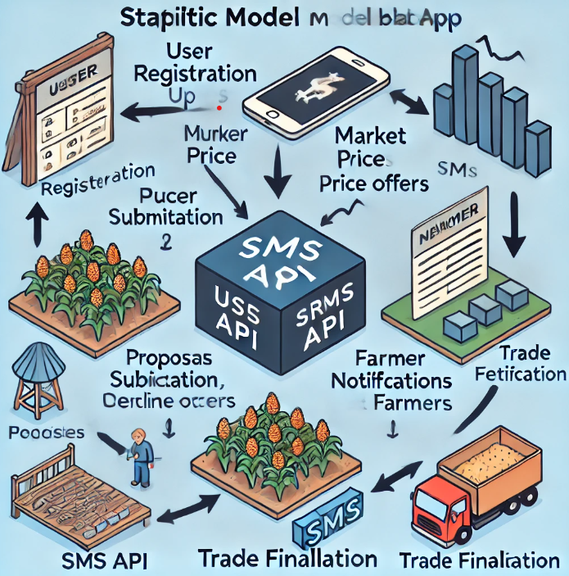
Seshadri Rao Gudlavalleru Engineering College
Seshadri Rao Knowledge Village, Gudlavalleru - 521356
AgriConnect : Bridging Farmers and Markets For Fair Trade
Abstract
The project connects farmers to markets via web app, ensuring fair trade, real-time pricing, and sustainability while enhancing market access and economic resiliences.
System Requirements
Windows 64 bit/Linux
Xampp server for backend Management
Compatable Web Browser
Methodology
Farmer Registration
Marketer Registration
Real-Time Pricing
Proposal Submission
SMS Notification System
Farmer Decision
Trade Finilization
Block Diagram
Working principle
Farmers and marketers register on the platform with contact details.
The system provides updated market prices to ensure informed decision-making.
Marketers browse available crops and send price offers via the web app.
Farmers receive price offers through an SMS API, ensuring accessibility without internet.
Farmers respond via SMS or platform; transactions finalize upon agreement.
Increased Farmer Participation
Faster Price Communication
Fair Trade Practices
Improved Market Access
Transaction Efficiency.
Conclusion
This project outcome is to ensure fair trade, transparency, direct market access, farmer empowerment through sms-based communication,enhancing economic stability and sustainability.
Results
Student Names: K.Teja,G.Eswari Devi,M.Amaleswari,L.Kiran Kumar
Under the Guidance of Mrs T.Sumallika M.Tech, (Ph.D).

